Slide 1
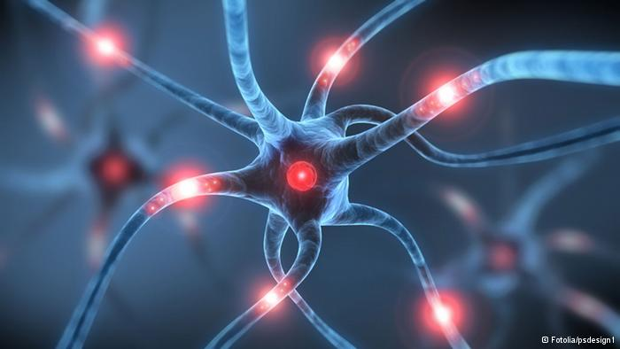
Epilepsy and the EFHC1 Gene
Victoria Van Vreede

Slide 2
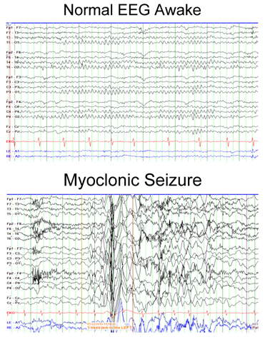
What is Epilepsy?
https://www.youtube.com/watch?v=qAgyms7j5EA
Notes:
So when I say the word epilepsy, I’m guesing most of you have the same image: a seizure, and convulsions on the ground. But epilepsy is a lot more complicated than that. Epilepsy is defined by the presence of RECURRENT seizures. Seizures happen when there is improper firing of neurons – whether in a small part of the brain, or a firing of neurons throughout the entire brain. Here an EEG measures brain activity in a normal and seizing state. As you can see, in a myoclonic seizure all areas of the brain light up for very brief period of time. This is not the type of seizure you typially image. And this is a myoclonic seizure .
I’ll now show you the video of someone who has juvenile myoclonic epilepsy to demonstrate what these symptoms are like.

Slide 3
Mutations in EFHC1 cause epilepsy
65% R182H
R221H
P77T
D210N
D253Y
DM10
DM10
DM10
EF
EFHC1 Gene

Slide 4
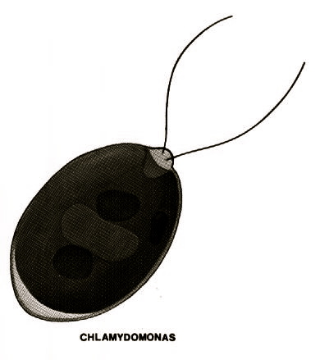
How well conserved is EFHC1?
99%
84%
61%
39%
53%
42%
DM10 Domain
EF Hand Domain
Notes:
Decided to look specifically at this green algae cell because green algae don’t have complex nervous systems!!! No neurons firing. So what is EFHC1 doing there???

Slide 5
What does EFHC1 interact with?
Ion Channel Proteins
Spermatogenesis
Notes:
What do sperm cells and neuron cells have in common?? Extensive microtubule structures.

Slide 6
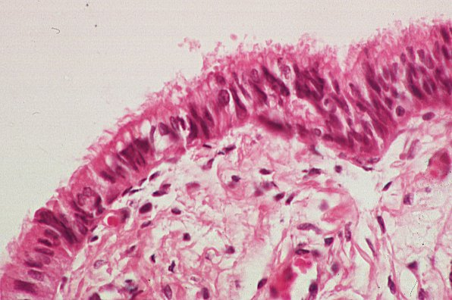
What are EFHC1’s go terms?
Ependymal cilia, trachea cilia
sperm flagellum,
neuronal cell body
and dendrites
Mitotic spindle
Notes:
What do sperm cells and neuron cells have in common?? Extensive microtubule structures.

Slide 7
Where are EFHC1 homologs found?
Rib72
DM10
DM10
DM10
EF
39%

Slide 8
Could DM10 domains affect neuronal microtubule structure?
Notes:
Info traffiked along microtubules! Protein involved in putting information on the microtubule. (info involving CA levels)

Slide 9
Hypothesis
DM10 domains bind microtubule structures

Slide 10
Specific Aim #1
Determine which DM10 domains bind microtubules
Hypothesis: Each DM10 domain will show binding affinity for microtubule segments
A
B
C

Slide 11
Specific Aim #1
Binds Microtubules
+
A
B
C
EF
+
Exp 1
A
+
Exp 2
B
+
Exp 3
C
_
Exp 4
EF
Notes:
How to analyze?

Slide 12
To analyze conserved DM10 residues between EFHC1 homologs
Specific Aim #2
65% R182H
P77T
R221H
D210N
D253Y
DM10
DM10
DM10
EF
Hypothesis: All organisms will contain the conserved Arginine 182 amino acid within DM10 (A)

Slide 13
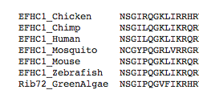
Specific Aim #2
DM10
DM10
DM10
EF
65% R182H
Notes:
mosquito and green algae- the most distant relatives of humans who DO NOT HAVE COMPLEX NERVOUS SYSTEMS

Slide 14
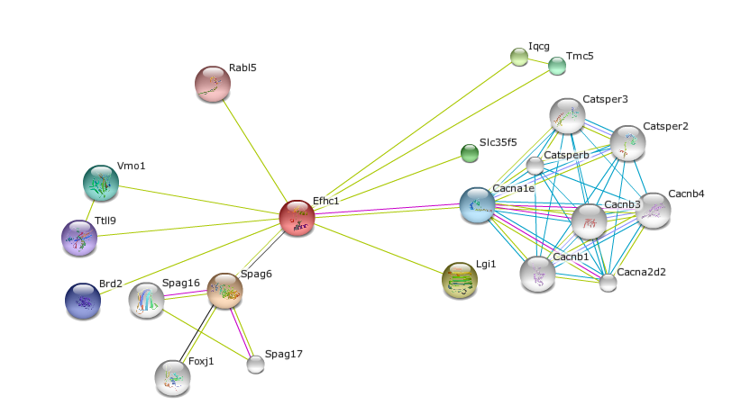
Specific Aim #3
To find the protein domains of EFHC1 interaction partners
Hypothesis: Many interacting proteins will contain microtubule-associated domains

Slide 15
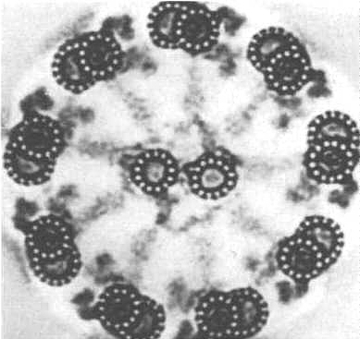
Specific Aim #3
TEK1 – tektin domain
forms protofilaments of
microtubules in flagellum
Ttll9 - tubulin-tyrosine kinase domain
Notes:
Second- post translatioal modifiation. Tektins are vital for the organization in cilia and flagellum.

Slide 16
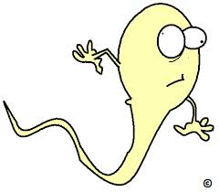
Conclusion and Future Directions
Investigate sterility in epilepsy
via microtubule dysfunction
DM10
DM10
DM10
EF

Slide 17
References
http://7bigspoons.com/fertility-2/thankfully-sperm-dont-directions/
http://www.chp.edu/CHP/juvenile+myoclonic+epilepsy
http://www.ncbi.nlm.nih.gov/homologene
Jara Prado et al. Novel Myoclonic/EFHC1 mutations in Mexican patients with juvenile myoclonic epilepsy. Seizure Journal 2012.
De Nijs et. al., Mutations of EFHC1, linked to juvenile myoclonic epilepsy, disrupt radial and tangential migrations during brain development. Oxford Journal. Volume 21 Issue 23. August 2012. http://hmg.oxfordjournals.org/content/21/23/5106.long
Genton et. al. Clinical Aspects of Juvenile Myoclonic Epilepsy. Epilepsy and Behavior Journal. Volume 28. July 2013. http://www.sciencedirect.com/science/article/pii/S152550501300005X
Delgado-Escueta et. al. The quest for Juvenile Myoclonic Epilepsy genes. Epilepsy and Behavior Journal. Volume 28. July 2013. http://www.sciencedirect.com/science/article/pii/S1525505012004957
De Nijs et. al., Juvenile myoclonic epilepsy as a possible neurodevelopmental disease: Role of EFHC1 or Myoclonin1. Epilepsy and Behavior. Volume 28. July 2013. http://www.sciencedirect.com/science/article/pii/S1525505012004969
King, Stephen. Axonemal Protoﬁlament Ribbons, DM10 Domains, and the Link to Juvenile Myoclonic Epilepsy. Cell Motility and the Cytoskeleton. Volume 63. 2006. http://onlinelibrary.wiley.com/store/10.1002/cm.20129/asset/20129_ftp.pdf?v=1&t=hturpcy2&s=ac620ef3194976e78700d12e0d250a790d2c6f20
Ikeda et. al. Rib72, a Conserved Protein Associated with the Ribbon Compartment of Flagellar A-microtubules and Potentially Involved in the Linkage between Outer Doublet Microtubules. Journal of Biological Chemistry. November 2012. http://www.jbc.org/content/278/9/7725.abstract
http://en.wikipedia.org/wiki/File:Kinesin_cartoon.png
http://smart.embl.de/
http://string-db.org/newstring_cgi/show_network_section.pl
http://www.newconceptinfosys.com/ibm/imagegalerysecond.php?imageID=2
http://zaraweir.wordpress.com/

Slide 18
Questions?

